Slide 1
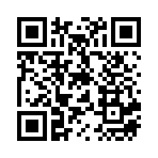
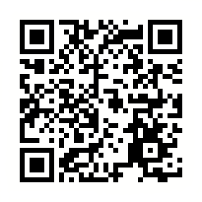
Online Language Exchange Session with Kanagawa Univ. Students
The purpose of this Language Exchange Session is to provide an opportunity for students to improve their language skills, cross-cultural communication,
and to meet new “friends” from another country even under the situation caused by COVID-19.
＊It will be held online by using Zoom.
Free of Charge!!!
Event Schedule (July 14th)
PM 06:00 -06:20
Welcome & Opening
Mini Presentations Given by Students from Kanagawa University
PM06:20 -06:50
Group Talks in Breakout Rooms
PM 06:50 -06:55
Break
PM 06:55 -07:25
Group Talks in Breakout Rooms (Different Groups)
PM 07:25 -07:30
Questionnaire, Group Photo and Closing!
Let’s talk and enjoy cross-cultural communication with students in JAPAN!
皆さんの参加をお待ちしてます！
Please apply from this QR code below!
👇
Check the previous
session’s report. 👉
お問合せ(Contact):intl-dispatch@kanagawa-u.ac.jp

